Slide 1


Expert Intervention Learning
1
Shaunak Mehta and Ananth Jonnavittula
[1] Expert Intervention Learning by Spencer et al.

Slide 2
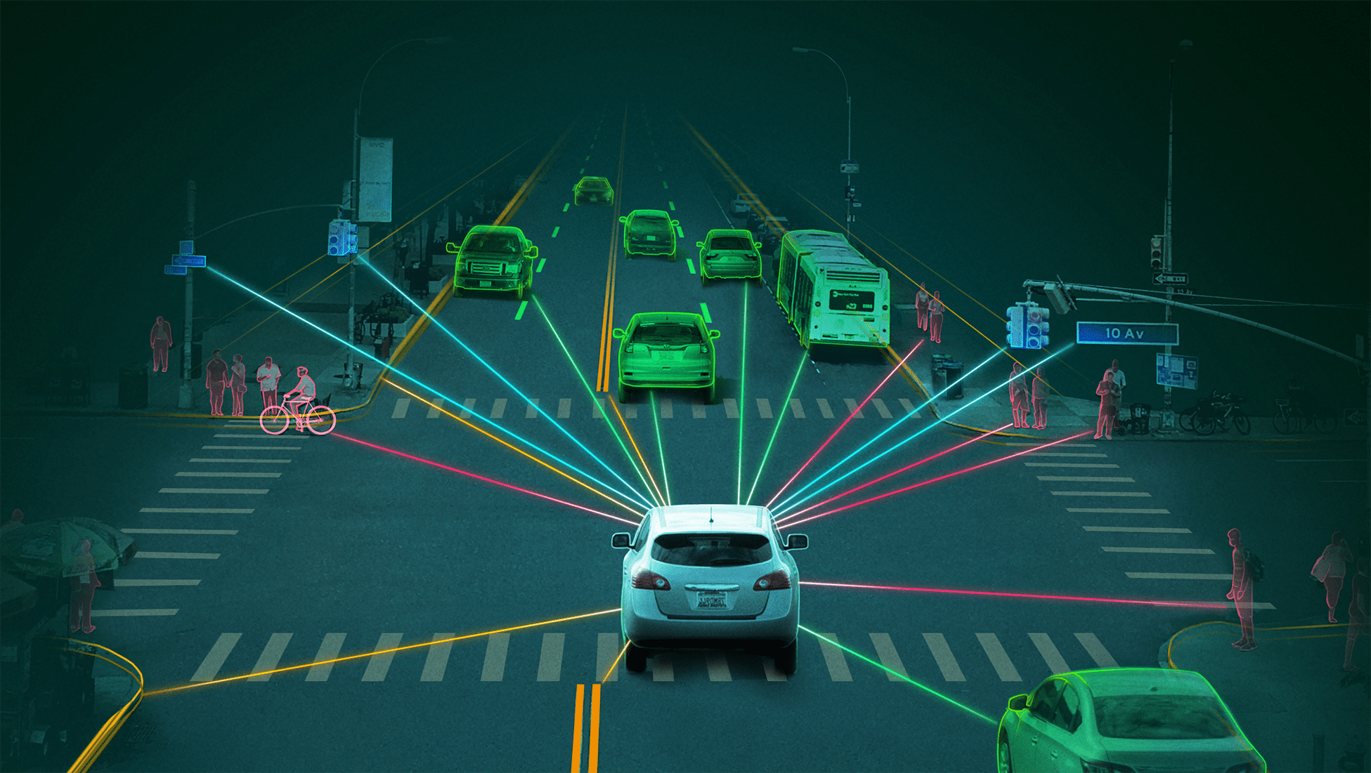

Slide 3



Slide 4


Behavior Cloning
Human provides demos
Trajectories with state and action pairs
Train a policy
$$π\left(s\right)= \underset{a}{arg min}{C_{θ}\left(s, a\right)}$$
Demos

Slide 5
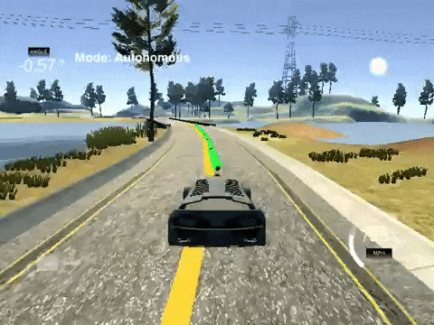

Slide 6
Pros
Behavior Cloning
Cons
Simple to implement
Works well for straightforward tasks
Requires large amounts of data
Covariate Shift
Unpredictable when it encounters previously unseen states

Slide 7
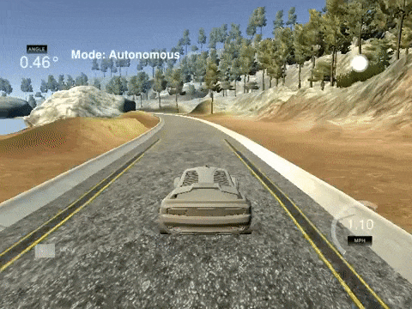

Slide 8

DAGGER
Human provides demos
Train a policy
Roll out policy
Query human for labels at every state
Demos
Policy
Correction

Slide 10
Pros
DAGGER
Cons
Optimal even with extreme covariate shift
Requires fewer demonstrations than behavior cloning
Requires a label for every single state
Queries are redundant and taxing

Slide 11
Demos
Policy
Correction

Slide 12
RG-DAGGER
Human provides demos
Train a policy
Roll out policy
Robot asks human to intervene
Demos
Policy
Correction

Slide 13
Pros
RG-DAGGER
Cons
Requires fewer labels from human
Reduces burden on the human
Unstable dynamics
Human cannot intervene whenever they want

Slide 14
Demos
Policy

Slide 15
HG-DAGGER
Human provides demos
Train a policy
Roll out policy
Human intervenes whenever they desire
Demos
Policy
Correction

Slide 16
Pros
HG-DAGGER
Cons
Human is in control of when to intervene
Better stability
Not as data efficient as it can be
Does not utilize implicit human feedback

Slide 17
Demos
Policy
Correction

Slide 18
Summary
Human provides demos
Train a policy
Roll out policy
Human intervenes whenever they desire
Demos
Policy
Correction

Slide 19

Problem Formulation
The problem is formulated as a MDP with unknown rewards:
$$ℳ\left(𝒮, 𝒜, 𝒫,𝒯,𝒹_{0}\right)$$
The initial policy is trained as:
$$π\left(s\right)= \underset{a}{arg min}{C_{θ}\left(s, a\right)}$$

Slide 20
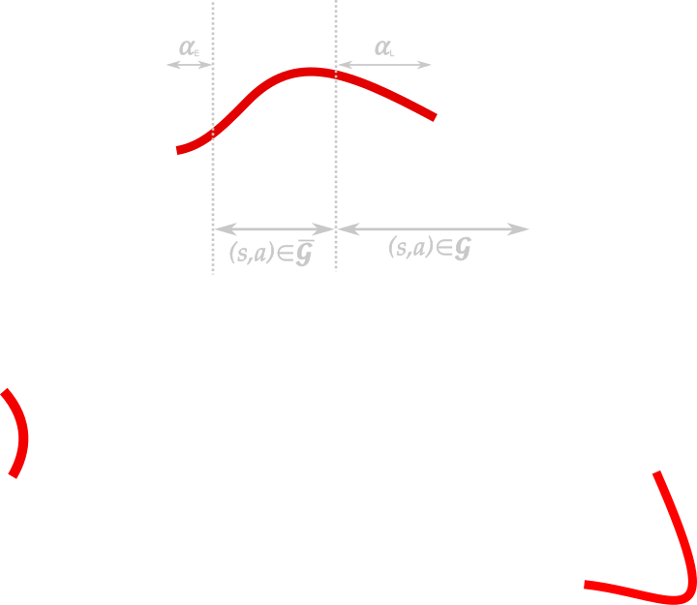
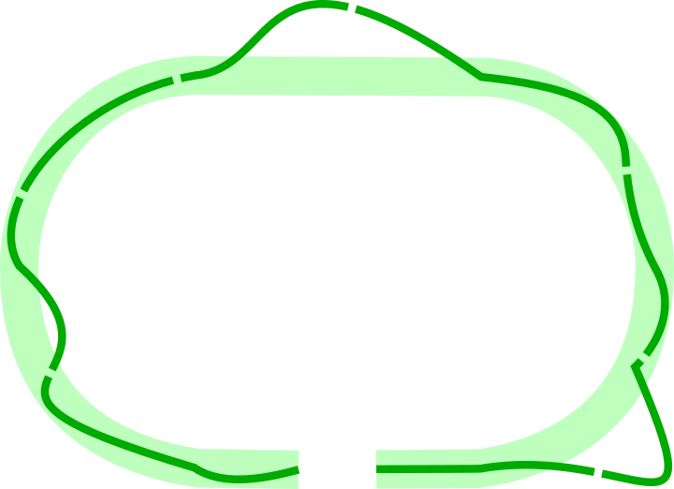


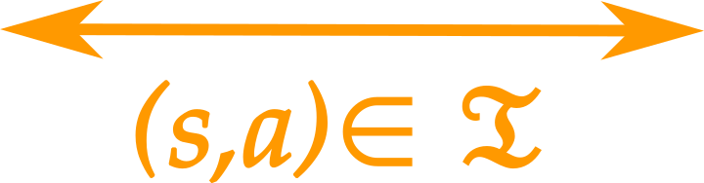
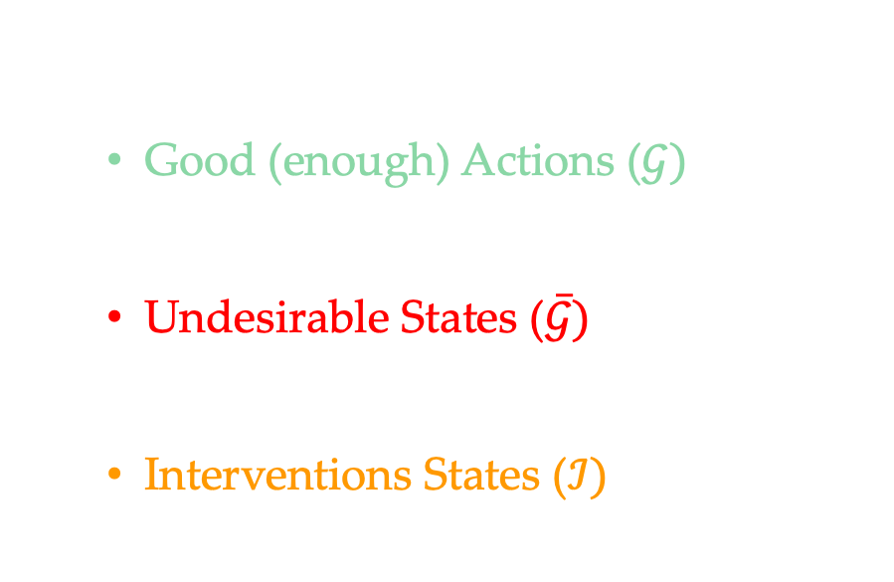
Expert Intervention Learning
The state-action space comprises of three parts:
Good (enough) Actions ($𝒢)$
$$C_{θ}\left(s,a\right)≤B$$
Undesirable States ($\overline{𝒢})$
$$C_{θ}\left(s,a\right)>B$$
Interventions States ($ℐ)$
$$C_{θ}\left(s,a\right)<C_{θ}\left(s, a^{′}\right)$$

Slide 21
Expert Intervention Learning
The learner's objective: Perform "Good Enough" actions so that the expert does not have to intervene.

Slide 22

Expert Intervention Learning
The loss function for this problem is defined as:
$$\min_{π∈Π}{E_{s\sim d_{π}}{[1}_{\left\{\left(s,π\left(s\right)\right)∉𝒢\right\}}]+λE_{s^{ℐ}\sim d_{π}^{ℐ}}[1_{\left\{π\left(s^{ℐ}\right)≠π^{E}\left(s^{ℐ}\right)\right\}}]}$$
$λ$ is a tuning constant
Stay in good enough region
Learn intervention actions
Notes:
Emphasize that this function is non-convex and the need to make it convex.

Slide 23

Algorithm
Initialize $𝒢, \overline{𝒢}$ and $ℐ$ as {}
Initialize $π_{1}$ to any policy $Π$
for $n=1, …, N$ do
Execute learner policy $π_{ θ_{i}}$
Get learner trajectory $ξ_{L}$ and intervention trajectory $ξ_{E}$
Aggregate (s, a) pairs to datasets $𝒢, \overline{𝒢}$ and $ℐ$
Minimize loss to compute new parameter $θ_{i+1}$
return best parameter from $θ_{1}, …, θ_{N}$

Slide 24
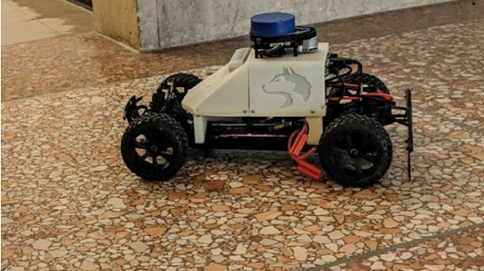
Experiments

Slide 25
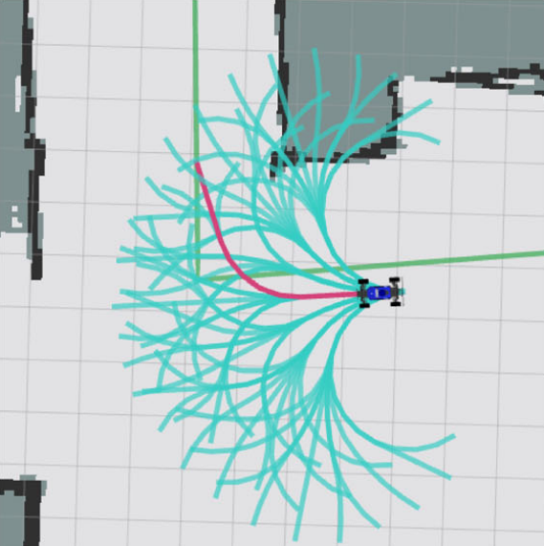
Task
Part 1: Navigating through a straight hallway
Part 2: Navigating a sharp corner

Slide 26
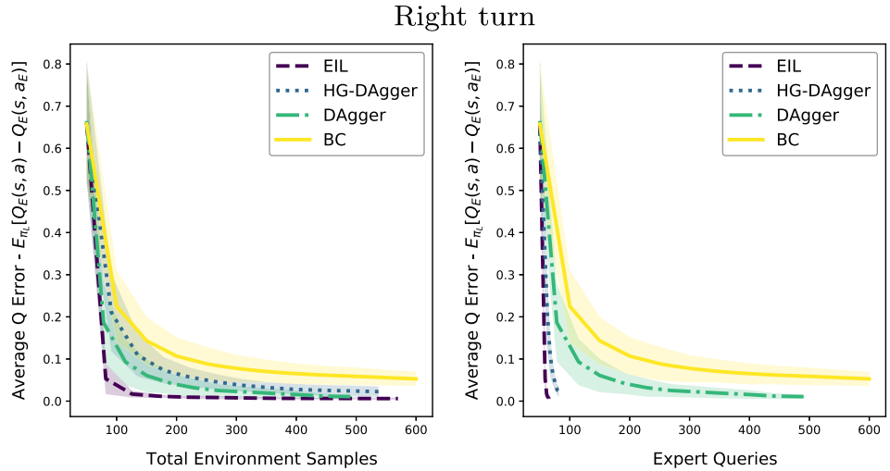
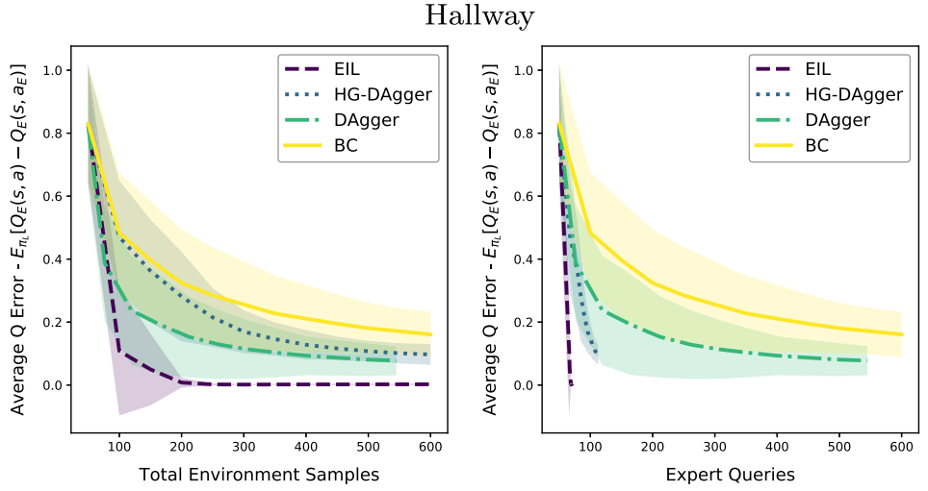
Simulated Human
EIL outperforms all the baselines
The hallway task was found to be more challenging

Slide 27
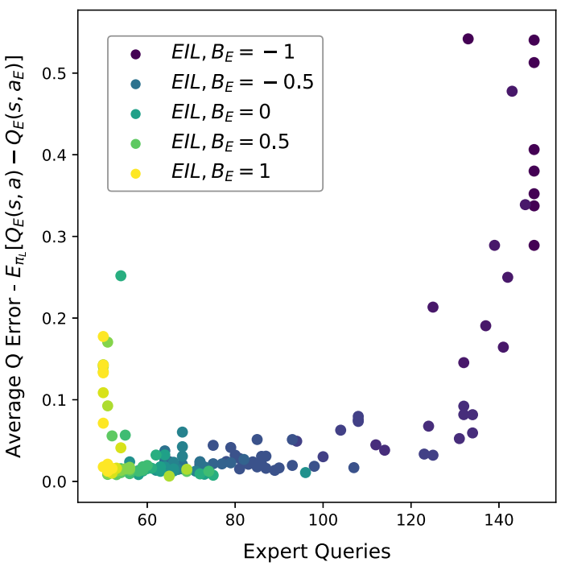
Simulated Human
There exists an optimal level of intervention which minimizes both, the human effort and learner error

Slide 28
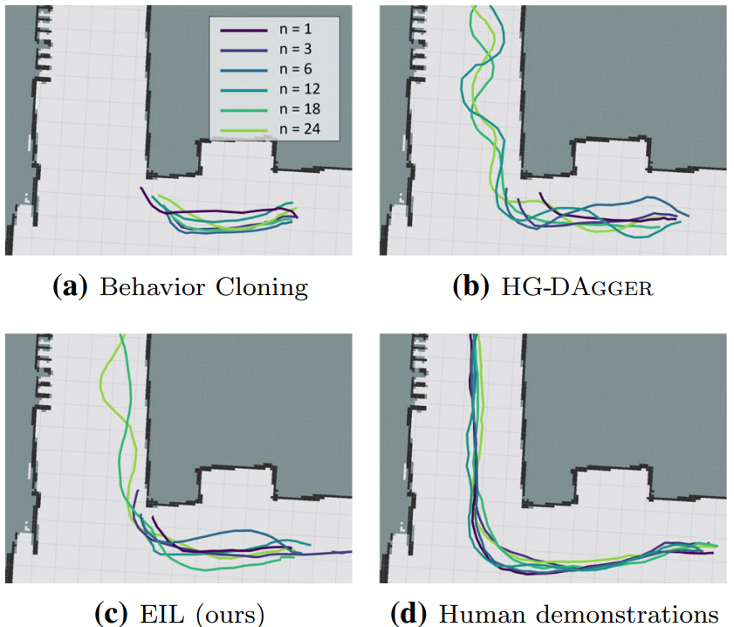
Real Human
Implicit feedback provides a performance boost over the baselines

Slide 29
Summary
State-action space is broken down into three parts
Perform “good enough” actions
Formulate a loss function

Slide 30
Pros – Expert Intervention Learning
Makes use of explicit and implicit feedback from the human
Formalizes ”good enough” performance
Provides theoretical guarantees for performance

Slide 31
Cons – Expert Intervention Learning
No user study
Expert must truly be an expert
Still requires large amounts of data
311 interactions

Slide 32
Expert Intervention Learning
1
Shaunak Mehta and Ananth Jonnavittula
1 Expert Intervention Learning by Spencer et al.

